Slide 1
Jeff Knowles Townsville Orchid Society Inc. May, 2022
Notes:
TIOS 2014

Slide 2
FOOD!
Jeff Knowles
Townsville Orchid Society Inc.
May, 2022

Slide 3
Food

Slide 7
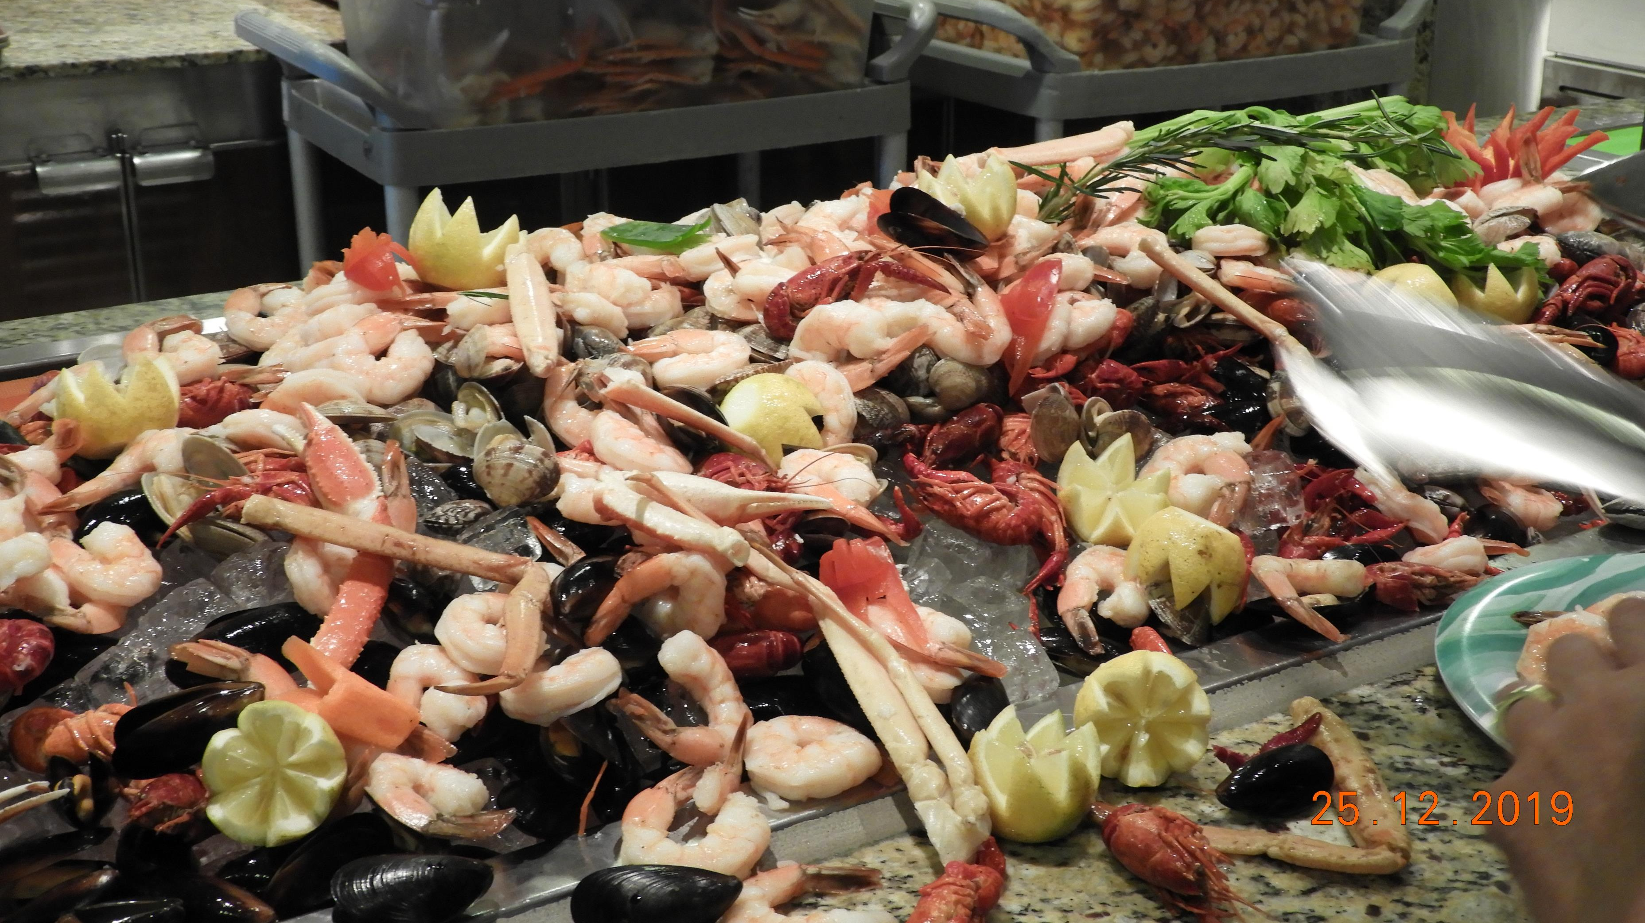

Slide 10
If you grow your orchids for . . .

Slide 11
Will fertiliser make a difference?

Slide 12
Some research findings
“Plants had a wider leaf spread, produced more and larger leaves, and had greater total leaf areas in response to the higher fertilizer concentration, regardless of which fertilizer was used.”
Yin-Tung Wang, Department of Horticultural Sciences, Texas A & M University Agricultural Research and Extension Center, 2415 East Highway 83, Weslaco, TX 78596, U.S.A.

Slide 13
Or – simply put . . .
Just using water is OK
but
Fertiliser is better.

Slide 14
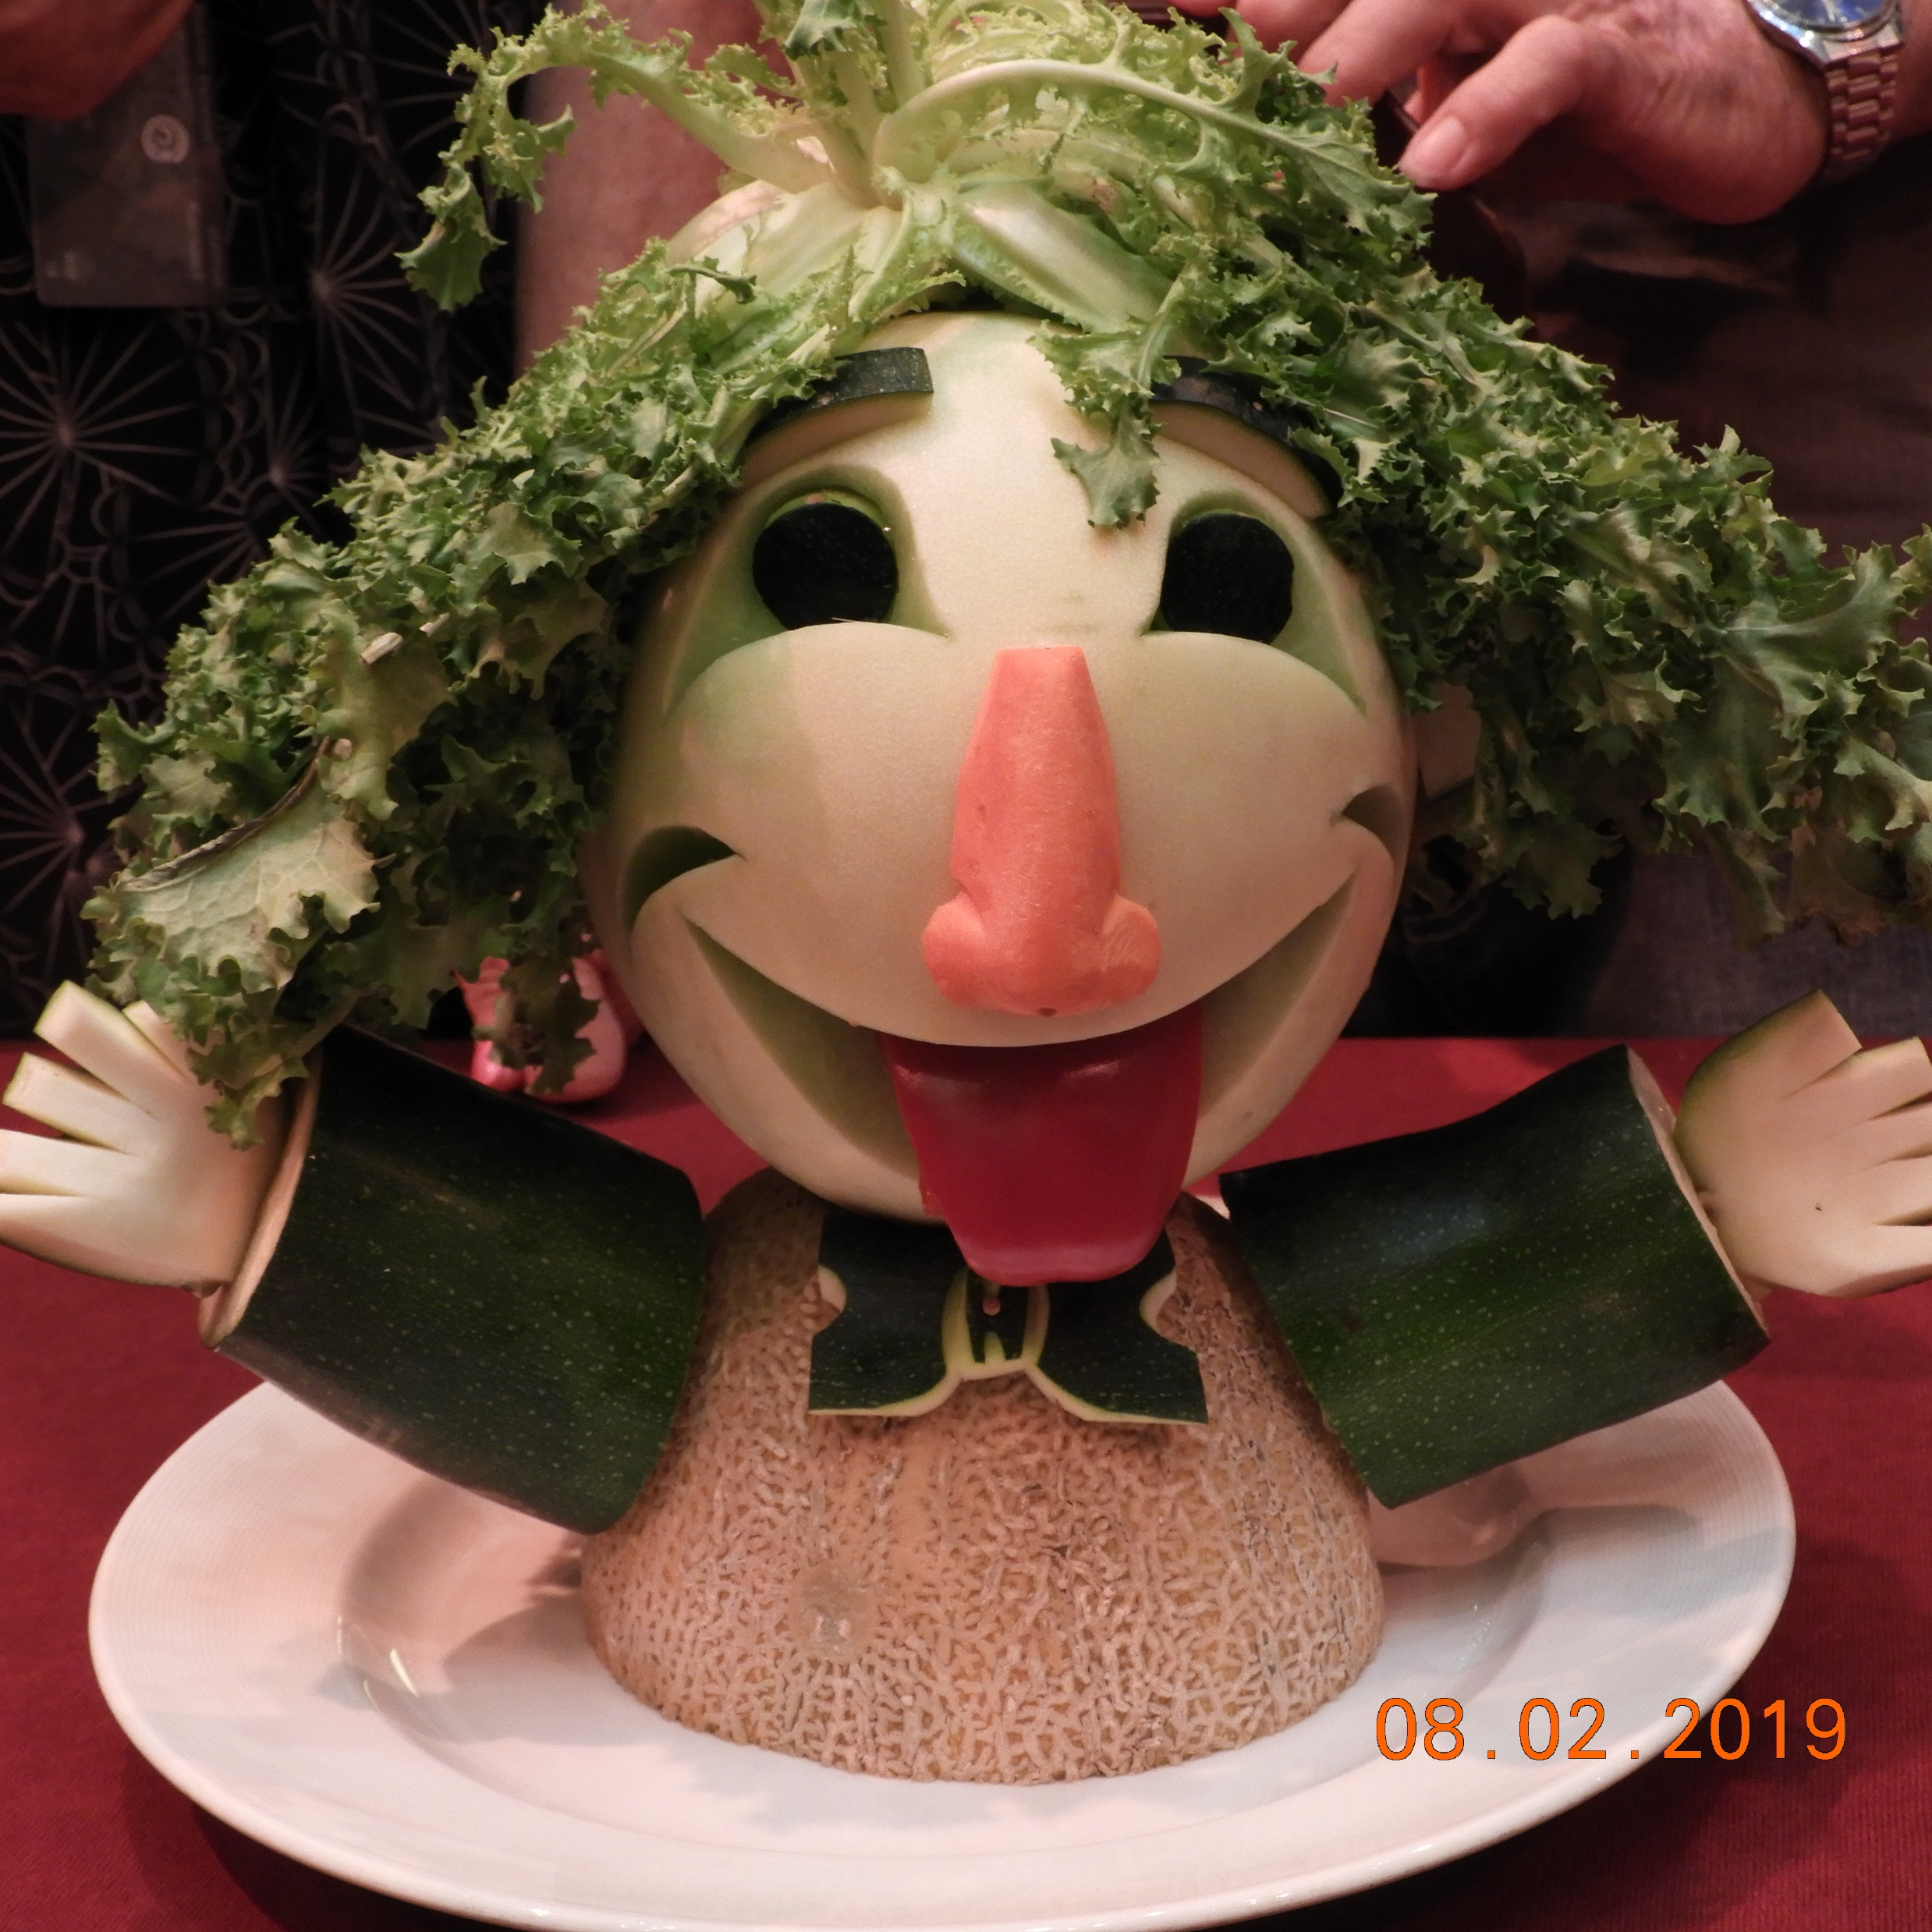

Slide 15
Menu – main courses
Macro
(major ones, needed in largest amounts)
Minor
(Needed in smaller amounts)
Micro
( Only needed in small amounts)

Slide 16
Macro-nutrients
Nitrogen (N)
Phosphorus (P)
Potassium (K)
N : P : K = 20 : 2 : 16
N : P : K = 20%N : 2%P : 16%K

Slide 17
Care with NPK
Australia (elemental nutrient)
N : P : K = 20 : 8.7 : 16.6
USA
N : P : K = 20 : 20 : 20
(N : P2O5 : K2O)

Slide 18
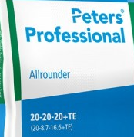
Care with NPK

Slide 19
Macro-nutrients

Slide 20
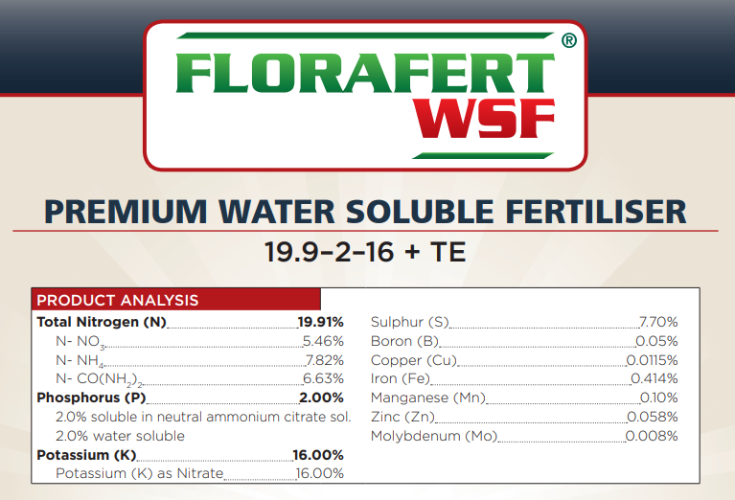
Care with Nitrogen

Slide 21
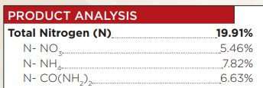
Nitrogen - 3 forms in fertilisers
Nitrate ions Ammonium ions Urea

Slide 22
Nitrogen - 3 forms in fertilisers
Nitrate ion---- NO₃⁻
Immediately available for uptake by the roots.
Ammonium ion ---------- NH₄⁺
Immediately available for uptake by the roots.
Urea ------------- CO(NH₂)₂
Must be converted to ammonium ion by the enzyme urease in the orchid roots and microorganisms in the root zone.

Slide 23
Minor nutrients
Calcium (Ca)
Magnesium (Mg)
Sulfur (S)

Slide 25
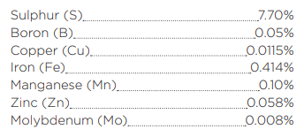
Minor nutrients – Ca, Mg, S

Slide 26
Minor nutrients
Calcium (Ca) – Add Calcium Nitrate
Magnesium (Mg) – Add Epson Salts
Sulfur (S) – usually in the fertiliser

Slide 27
Micro Nutrients (trace elements - TE)
Iron (Fe)
Manganese (Mn)
Zinc (Zn)
Copper (Cu)
Boron (B)
Molybdenum (Mo)
Sodium (Na) Chlorine (Cl) Nickel (Ni)
Additionally, it appears that both silicon (Si) and cobalt (Co) may play a beneficial role in plant health.
Notes:
See list on water/fertiliser checking table.

Slide 29
Minor nutrients (TE) - Fe, Mn, Zn, Cu, B, Mo

Slide 30
Menu – dessert
Growth Hormones
NAA, IAA, B1
Other goodies
Seaweed, blood and bone, fish, worm wee,
Molasses

Slide 31
Growth hormones

Slide 32
Growth hormones

Slide 33
Growth Promoter
Notes:
Note: no N:P:K

Slide 34
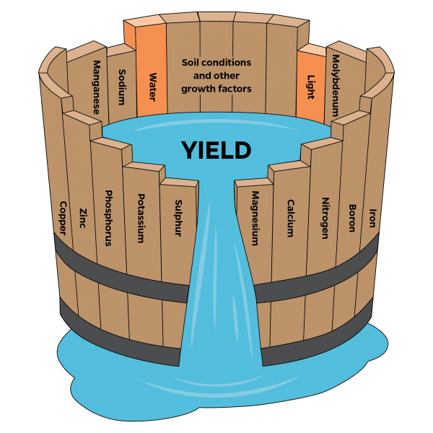
Plant Growth Laws
1. Liebigs “Law of Minimum”
Growth is dictated not by total nutrients available but by the scarcest nutrient (limiting factor).

Slide 35
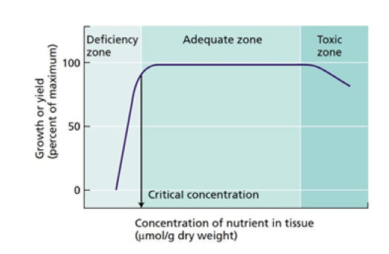
Plant Growth Laws
2. The three bears’ principle
- Not too little, not too much, just right.

Slide 36
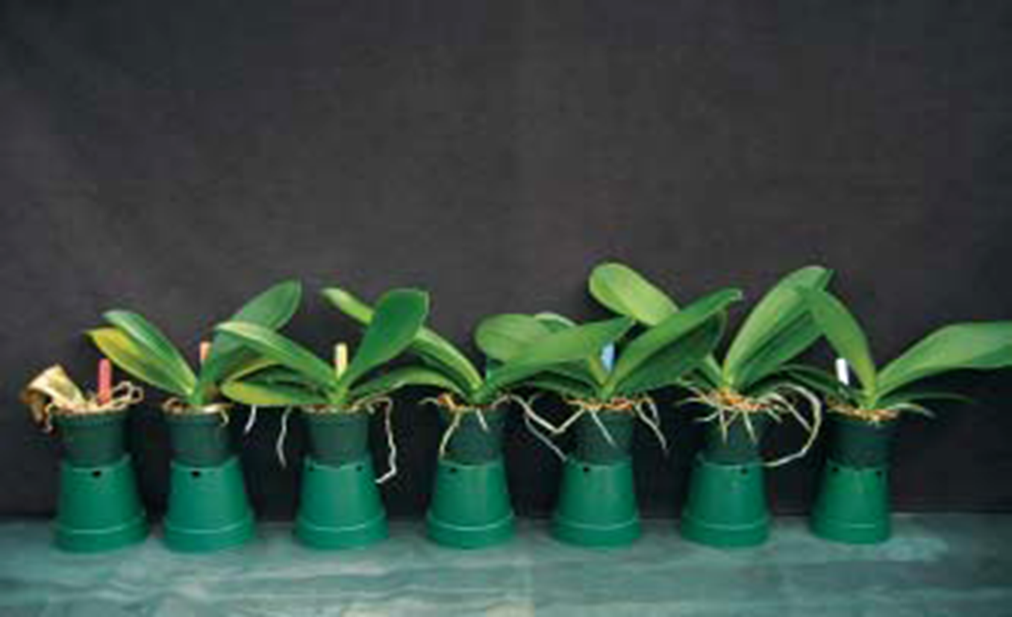
Plant Growth Laws
The plants received 0, 50, 100, 200, 300, 400,or 500 ppm potassium

Slide 37
Many professional growers base their nutrient concentrations on the amount of nitrogen provided to the plants, with 50 to 250 ppm N being common.

Slide 38
How to calculate the ppm of Nitrogen?
If 1 g of solid fertiliser (or 1mL if in liquid form) is dissolved in 1L of water:
Add a zero to the N% value to get the concentration of N in your mixed up, ready-to-use fertiliser.
Consider Jacks Professional Blossom Booster 10 : 13 : 17 + TE
1g dissolved in 1L water gives a fertiliser with 100ppm Nitrogen.
2g dissolved in 1L water gives a fertiliser with 200ppm Nitrogen
10g dissolved in 10L water gives a fertiliser with 100ppm Nitrogen
(ppm = parts per million) (10 : 30 : 20 in USA)

Slide 39
Plant Growth Laws
3. “Suck it up Baby”
Phalaenopsis absorb 85% of their requirements through their roots and 15% through their leaves. Wang – P. not able to absorb sufficient through their leaves.
Roots become saturated after 15-50 seconds.
Hydrophobic nature of roots and media.

Slide 40
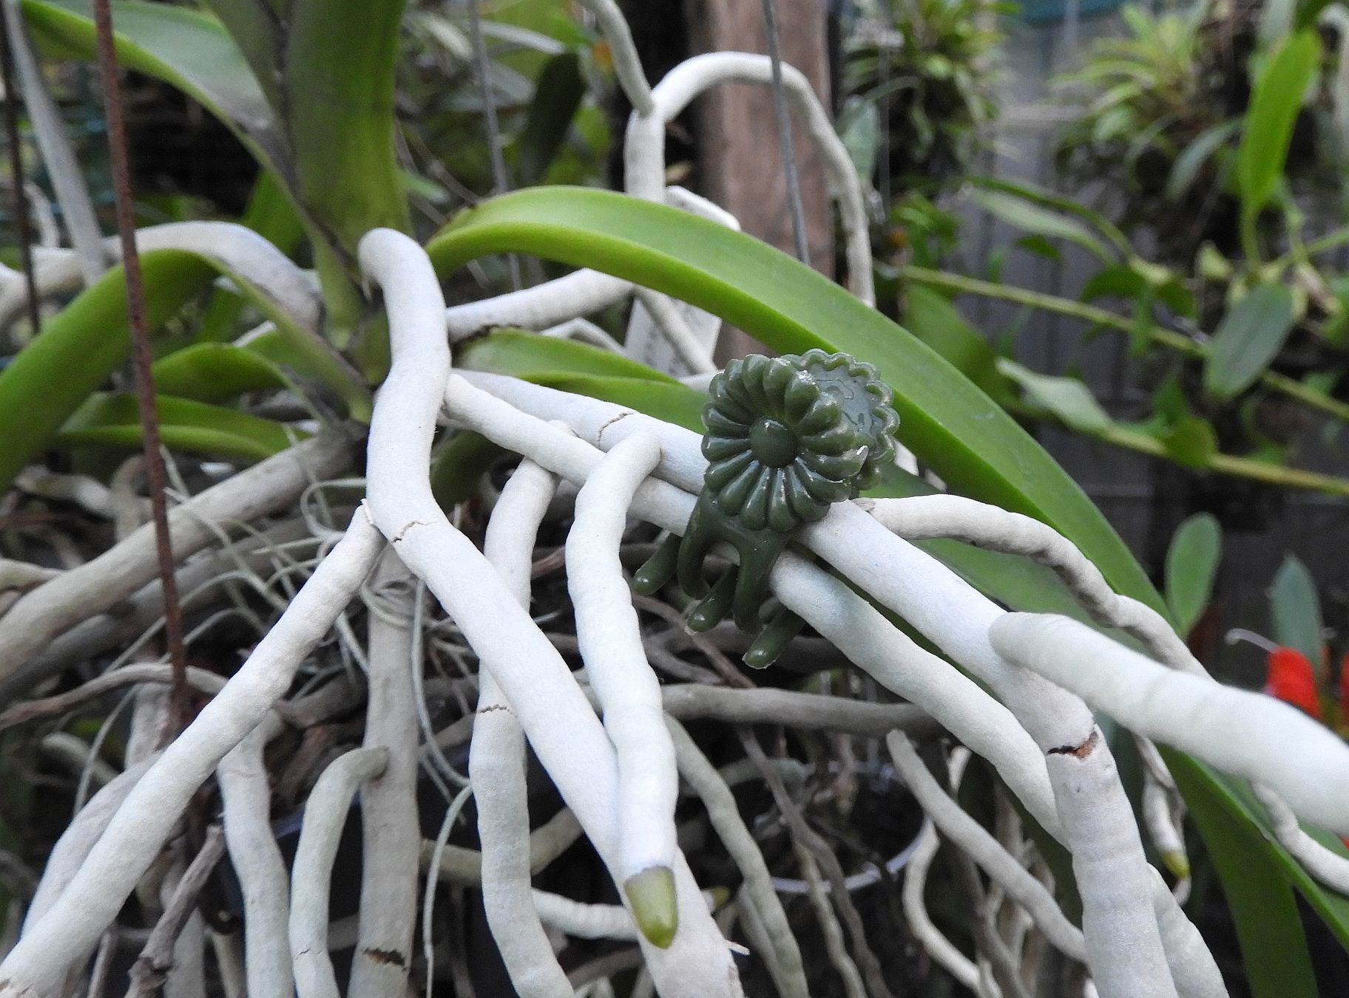
3. “Suck it up Princess” dry
Notes:
Dry- Ready to fertilise or water

Slide 41
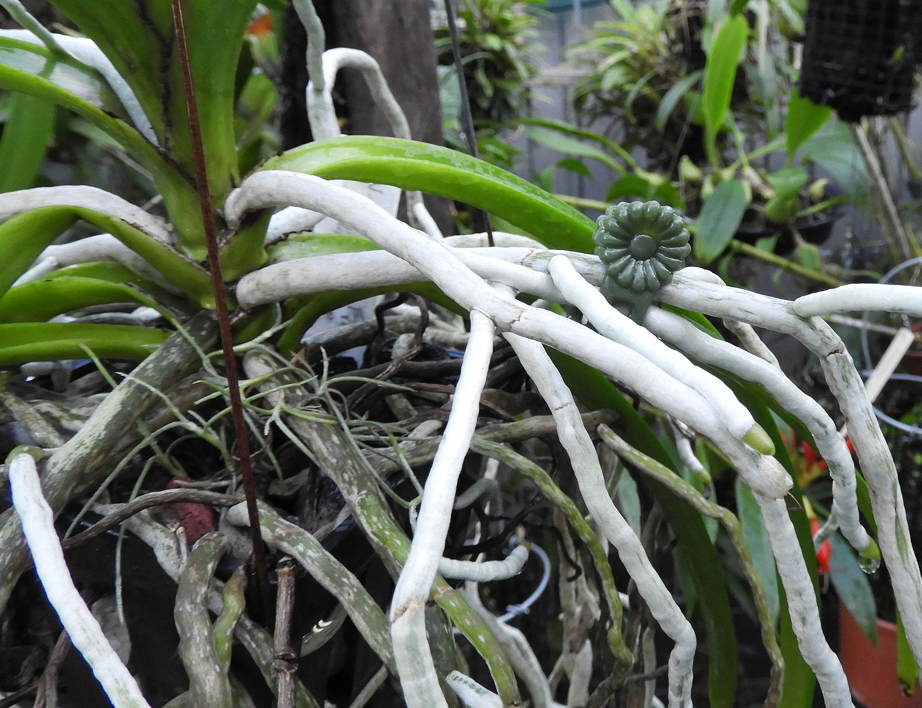
3. “Suck it up Princess” 1
Notes:
One pass of water

Slide 42
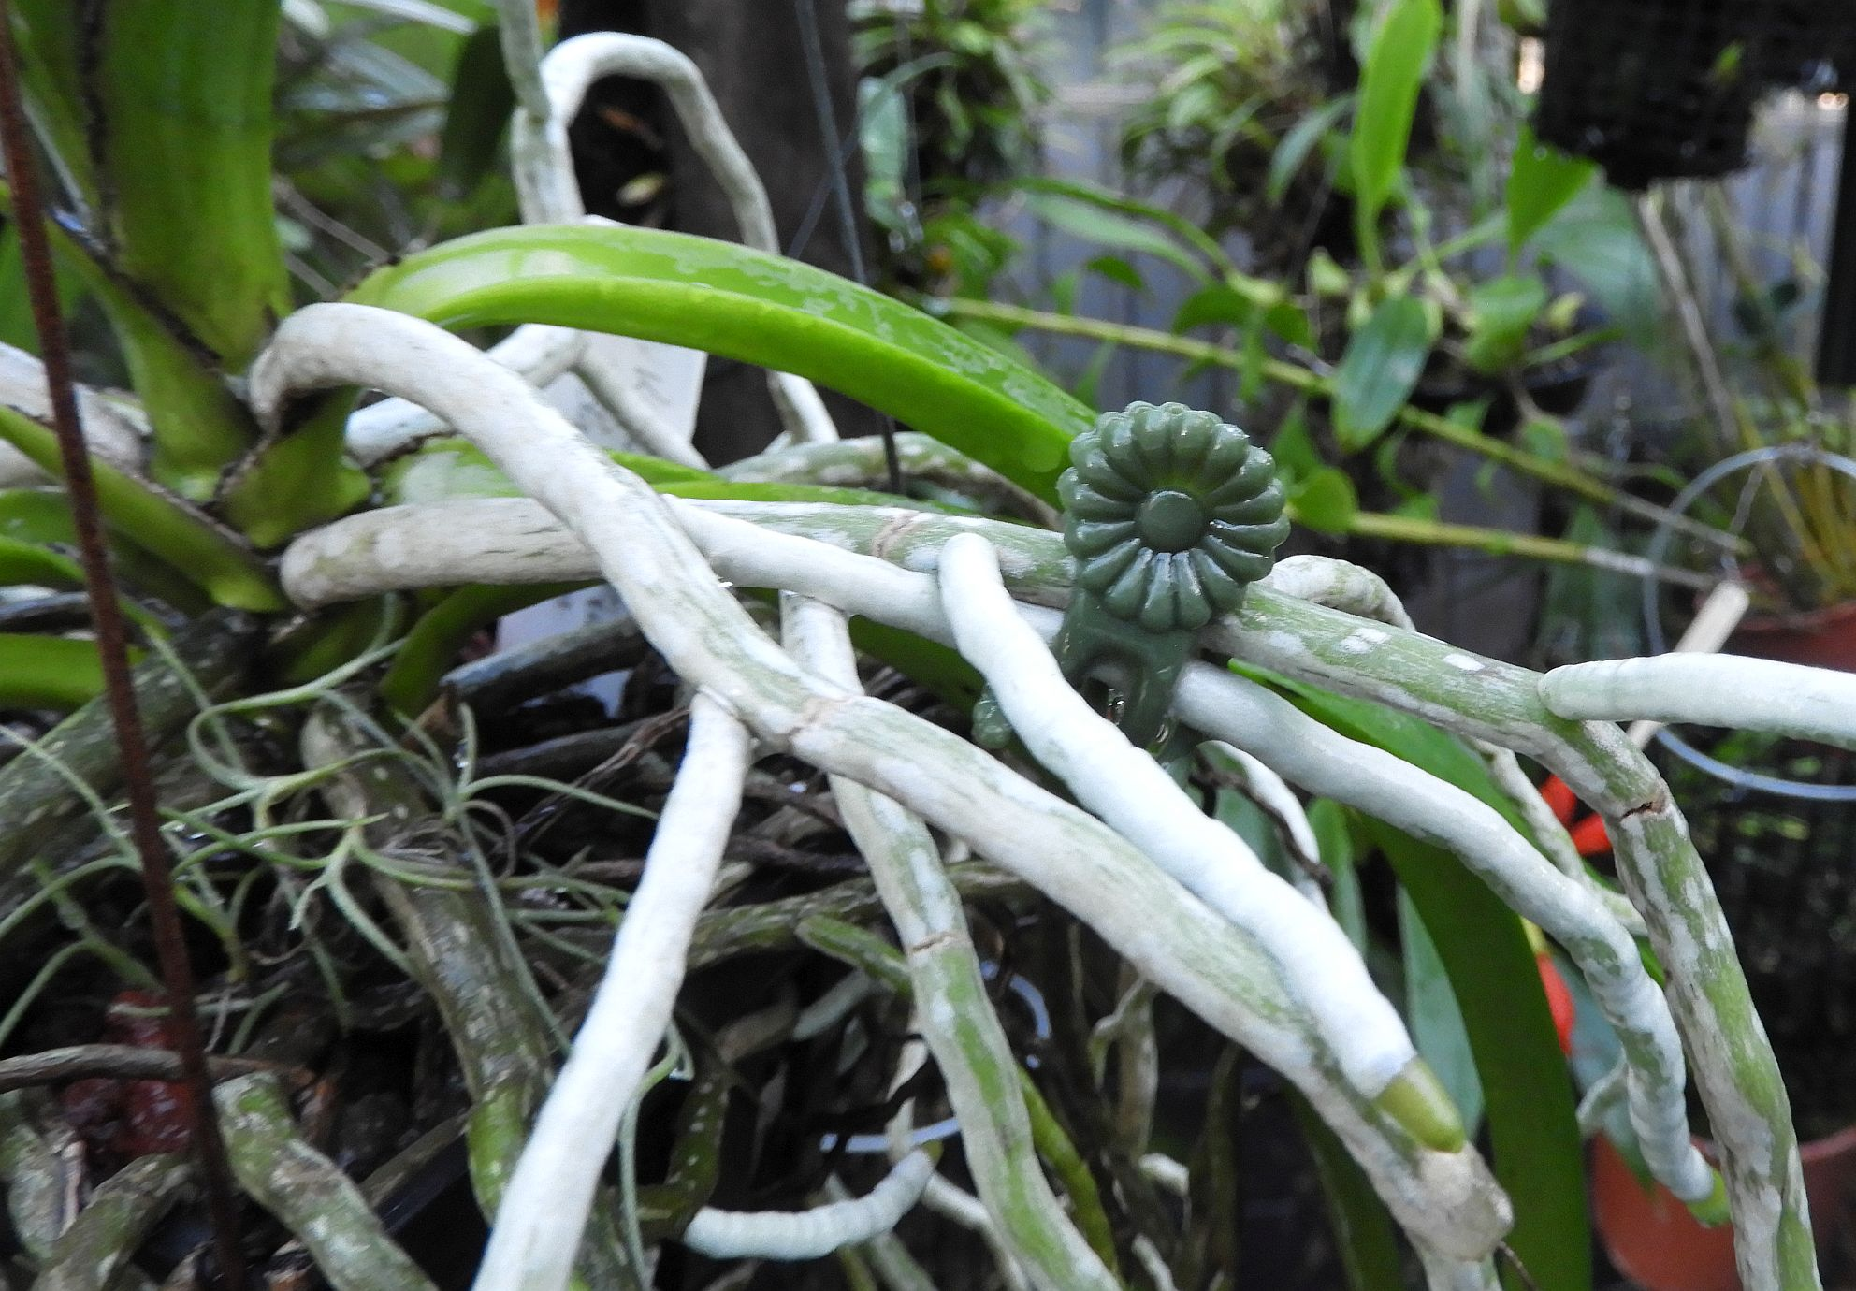
3. “Suck it up Princess” 2
Notes:
Two passes of water

Slide 43
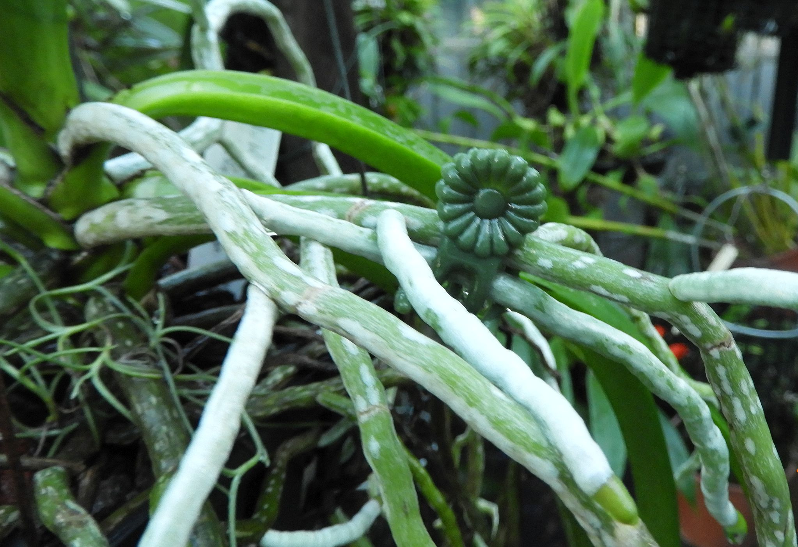
3. “Suck it up Princess” 3
Notes:
Three passes of water

Slide 44
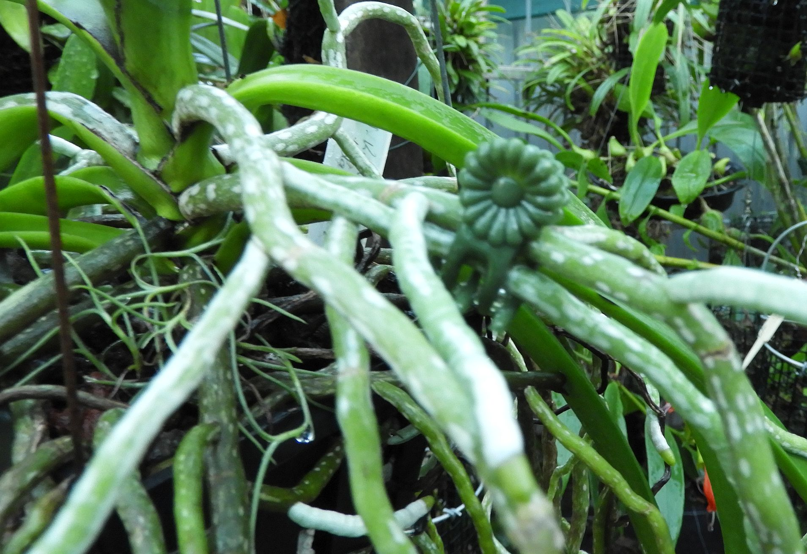
3. “Suck it up Princess” 4
Notes:
Four passes of water

Slide 45
3. “Suck it up Princess” Overall
Notes:
overall

Slide 46
Plant Growth Laws
4. pH affects uptake of nutrients

Slide 47
pH

Slide 48
pH and nutrient uptake

Slide 49
Plant Growth Laws
pH affects uptake of nutrients
To adjust or not to adjust?

Slide 50
How to fertilise.
Water soluble fertiliser
Water first???
When -- morning, noon or night?
Slow release fertilisers
Solid stuff
Inorganic (e.g.GF9) and/or Organic (e.g. Seasol)
Use a spreader?
Chelated Trace Elements?

Slide 51
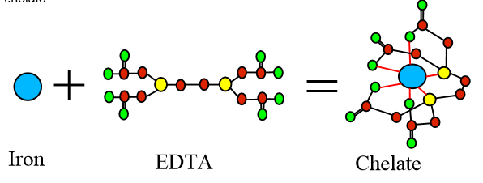
Chelated Trace Elements
Encapsulating the micro nutrient.
Nutrients are then more readily available for the plant to uptake.
Ethylenediaminetetraacetic Acid (EDTA)

Slide 52
In conclusion: Simply . . . .
Fertilise your orchids.
Fertilise regularly (Weekly? Written Plan?)
Feed orchids a variety of fertilisers
N P K -- Usually also contain trace elements
Calcium
Magnesium
Hormones
Stimulants

Slide 53
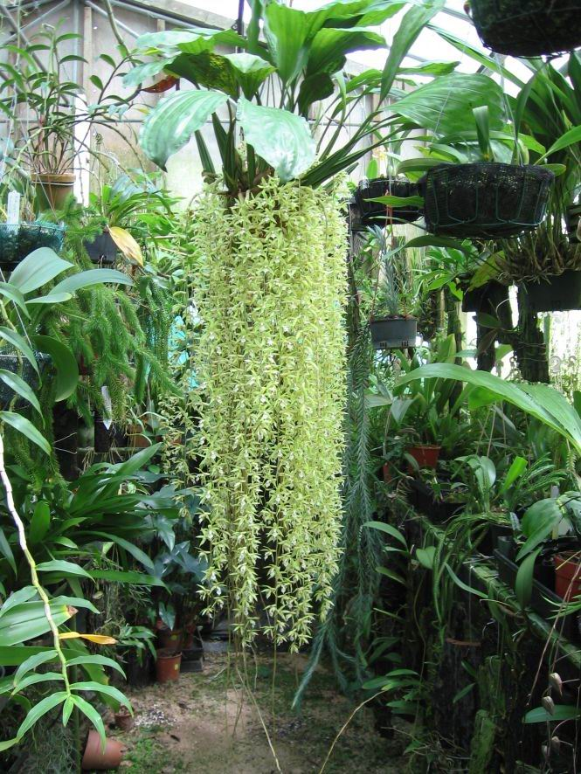
Feeding your orchids
Coel. rochussenii ‘Joy’ FCC-ACE/AOC
2004 to 2010
Jeff Knowles
Townsville Orchid Society Inc.
May, 2022

